Slide 1
CE 395R 5- Data Mining Future of Data Mining

Slide 2
Future of Data Mining
Data mining system products and research prototypes
Additional themes on data mining
Social impacts of data mining
Trends in data mining

Slide 3
How to Choose a Data Mining System?
Commercial data mining systems have little in common
Different data mining functionality or methodology
Data types: relational, transactional, text, time sequence, spatial?
System issues:
running on only one or on several operating systems?
a client/server architecture?
Provide Web-based interfaces and allow XML data as input and/or output?

Slide 4
How to Choose a Data Mining System? (2)
Data sources
ASCII text files, multiple relational data sources
support ODBC connections (OLE DB, JDBC)?
Data mining functions and methodologies
One vs. multiple data mining functions
One vs. variety of methods per function
More data mining functions and methods per function provide the user with greater flexibility and analysis power
Coupling with DB and/or data warehouse systems

Slide 5
How to Choose a Data Mining System? (3)
Scalability
Row (or database size) scalability
Column (or dimension) scalability
Visualization tools
“A picture is worth a thousand words”
Visualization categories: data visualization, mining result visualization, mining process visualization, and visual data mining
Data mining query language and graphical user interface
Easy-to-use and high-quality graphical user interface
Essential for user-guided, highly interactive data mining

Slide 6
Examples of Data Mining Software
WEKA
IBM SPSS
http://www-01.ibm.com/software/analytics/spss/
SAS Enterprise Miner
http://www.sas.com/technologies/analytics/datamining/miner/
IBM Analytics
https://www.ibm.com/analytics/us/en/?lnk=bua#
Microsoft SQLServer Analysis Services
https://docs.microsoft.com/en-us/sql/analysis-services/data-mining/data-mining-ssas?view=sql-analysis-services-2017
ESI Mineset
https://cloud.esi-group.com/analytics
Oracle Data Mining
http://www.oracle.com/technetwork/database/options/advanced-analytics/odm/overview/index.html
Megaputer
https://www.megaputer.com/site/index.php

Slide 7
Future of Data Mining
Data mining system products and research prototypes
Additional themes on data mining
Social impacts of data mining
Trends in data mining

Slide 8
Visual Data Mining
Visualization: use of computer graphics to create visual images which aid in the understanding of complex, often massive representations of data
Visual Data Mining: the process of discovering implicit but useful knowledge from large data sets using visualization techniques

Slide 9
Visualization
Purpose of Visualization
Gain insight into an information space by mapping data onto graphical primitives
Provide qualitative overview of large data sets
Search for patterns, trends, structure, irregularities, relationships among data.
Help find interesting regions and suitable parameters for further quantitative analysis.
Provide a visual proof of computer representations derived

Slide 10
Visual Data Mining & Data Visualization
Integration of visualization and data mining
data visualization
data mining result visualization
data mining process visualization
interactive visual data mining
Data visualization
Data in a database or data warehouse can be viewed
at different levels of abstraction
as different combinations of attributes or dimensions
Data can be presented in various visual forms

Slide 11
Data Mining Result Visualization
Presentation of the results or knowledge obtained from data mining in visual forms
Examples
Scatter plots and boxplots (obtained from descriptive data mining)
Decision trees
Association rules
Clusters
Outliers
Generalized rules

Slide 12
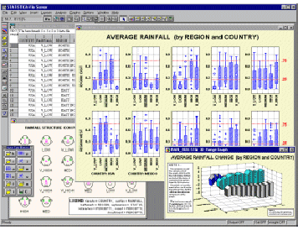
Boxplots from Statsoft: Multiple Variable Combinations

Slide 13
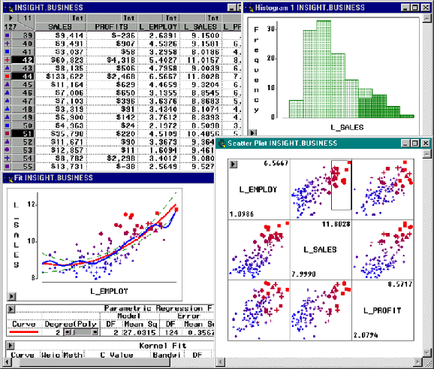
Visualization of Data Mining Results in SAS Enterprise Miner: Scatter Plots

Slide 14
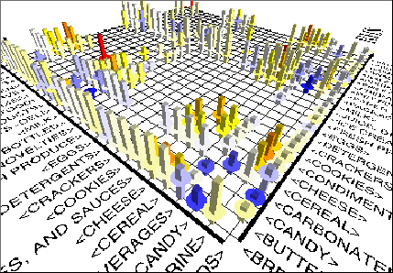
Visualization of Association Rules in SGI/MineSet 3.0

Slide 15
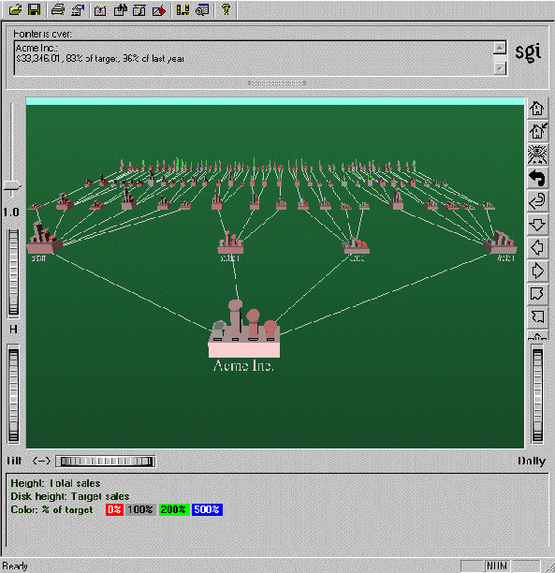
Visualization of a Decision Tree in SGI/MineSet 3.0

Slide 16
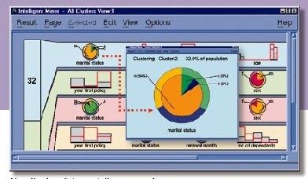
Visualization of Cluster Grouping in IBM Intelligent Miner

Slide 17
Interactive Visual Data Mining
Using visualization tools in the data mining process to help users make smart data mining decisions
Example
Display the data distribution in a set of attributes using colored sectors or columns (depending on whether the whole space is represented by either a circle or a set of columns)
Use the display to which sector should first be selected for classification and where a good split point for this sector may be

Slide 18
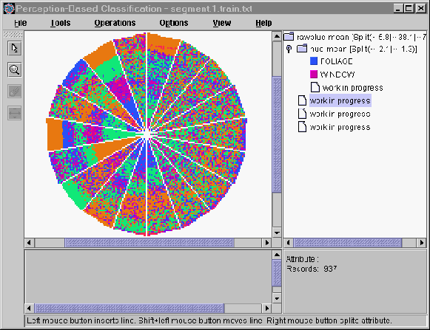
Interactive Visual Mining by Perception-Based Classification (PBC)

Slide 19
Audio Data Mining
Uses audio signals to indicate the patterns of data or the features of data mining results
An interesting alternative to visual mining
An inverse task of mining audio (such as music) databases which is to find patterns from audio data
Visual data mining may disclose interesting patterns using graphical displays, but requires users to concentrate on watching patterns
Instead, transform patterns into sound and music and listen to pitches, rhythms, tune, and melody in order to identify anything interesting or unusual

Slide 20
Future of Data Mining
Data mining system products and research prototypes
Additional themes on data mining
Social impacts of data mining
Trends in data mining

Slide 21
Is Data Mining a Hype or Will It Be Persistent?
Data mining is a technology
Technological life cycle
Innovators
Early adopters
Chasm
Early majority
Late majority
Laggards

Slide 22
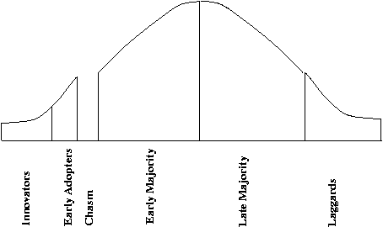
Life Cycle of Technology Adoption
Data mining is at Chasm!?
Existing data mining systems are too generic
Need business-specific data mining solutions and smooth integration of business logic with data mining functions

Slide 23
Data Mining: Merely Managers' Business or Everyone's?
Data mining will surely be an important tool for managers’ decision making
Bill Gates: “Business @ the speed of thought”
The amount of the available data is increasing, and data mining systems will be more affordable
Multiple personal uses
Mine your family's medical history to identify genetically-related medical conditions
Mine the records of the companies you deal with
Mine data on stocks and company performance, etc.
Invisible data mining
Build data mining functions into many intelligent tools

Slide 24
Social Impacts: Threat to Privacy and Data Security?
Is data mining a threat to privacy and data security?
“Big Brother”, “Big Banker”, and “Big Business” are carefully watching you
Profiling information is collected every time
credit card, debit card, supermarket loyalty card, or frequent flyer card, or apply for any of the above
You surf the Web, rent a video, fill out a contest entry form,
You pay for prescription drugs, or present you medical care number when visiting the doctor
Collection of personal data may be beneficial for companies and consumers, there is also potential for misuse
Medical Records, Employee Evaluations, Etc.
Notes:
Buying patterns, targeted marketing

Slide 25
Protect Privacy and Data Security
Fair information practices
International guidelines for data privacy protection
Cover aspects relating to data collection, purpose, use, quality, openness, individual participation, and accountability
Purpose specification and use limitation
Openness: Individuals have the right to know what information is collected about them, who has access to the data, and how the data are being used
Develop and use data security-enhancing techniques
Blind signatures
Biometric encryption
Anonymous databases

Slide 26
Future of Data Mining
Data mining system products and research prototypes
Additional themes on data mining
Social impacts of data mining
Trends in data mining

Slide 27
Trends in Data Mining (1)
Application exploration
development of application-specific data mining systems
Scalable data mining methods
Constraint-based mining: use of constraints to guide data mining systems in their search for interesting patterns
Integration of data mining with database systems, data warehouse systems, and Web database systems
Invisible data mining (mining as built-in function)

Slide 28
Trends in Data Mining (2)
Standardization of data mining language
A standard will facilitate systematic development, improve interoperability, and promote the education and use of data mining systems in industry and society
Visual data mining
New methods for mining complex types of data
More research is required towards the integration of data mining methods with existing data analysis techniques for the complex types of data
Privacy protection and information security in data mining

Slide 29
Trends in Data Mining (3)
Video Mining
http://www.videomining.com/
Fraud Detection
https://www.featurespace.com/
Deep learning
Deep Learning
The Department of Homeland Security Data Mining Reports
https://www.dhs.gov/publication/dhs-data-mining-reports
Has Consumer Data Mining Gone Too Far?
http://knowledge.wharton.upenn.edu/article.cfm?articleid=2886

Slide 30
The Future of our Discipline
“UC Berkeley’s Sitar has also noticed that some outstanding civil engineering graduates are going into jobs in areas such as data mining and risk analysis.”
http://www.graduatingengineer.com/futuredisc/civil2.html

